Slide 1




Data Science HACKATHON
EFFECT OF COVID-19 ON TRADE
A CASE STUDY OF NEW ZEALAND AND GHANA
Data Science Torque

Slide 2



Group Members Profile
Benedict Nartey
Data Scientist
Maame Oduro Yeboah
Data Scientist
Ibrahim Adam
Data Scientist

Slide 3

DS TORQUE
Data Findings

Slide 4
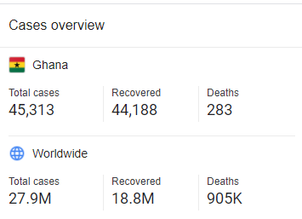
COVID-19 RECORDS IN GHANA
DS TORQUE

Slide 5
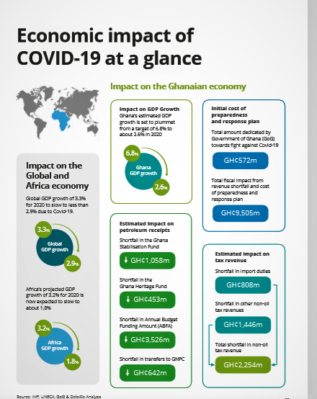
DS TORQUE

Slide 6
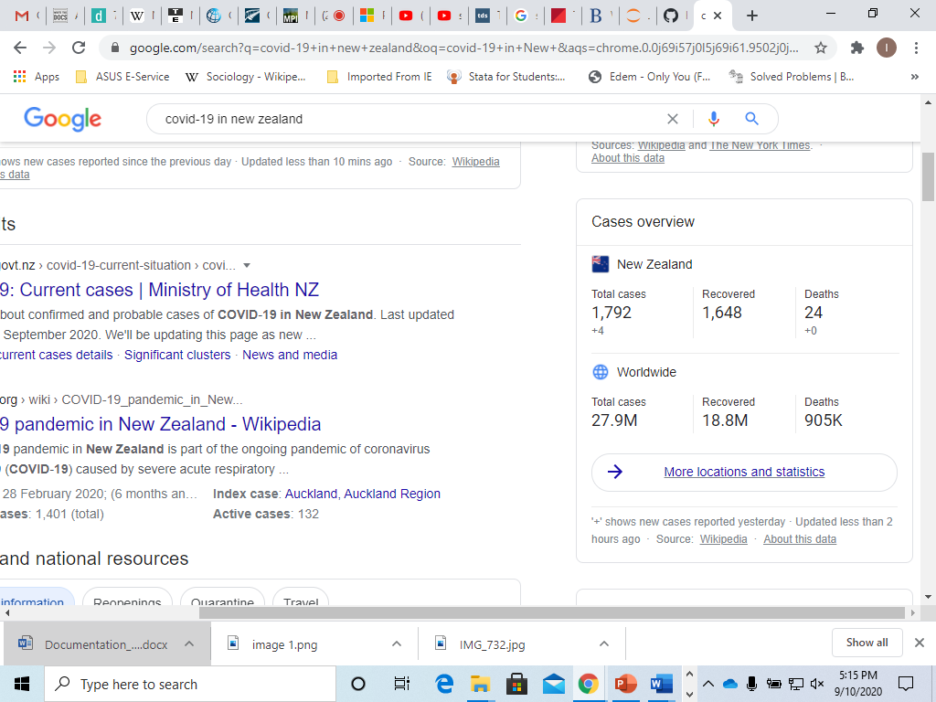
COVID-19 RECORD IN NZ
DS TORQUE

Slide 7
DS TORQUE
Problem Statement
The outbreak of COVID-19
Closure of borders and flights
Social distancing and subsequent lockdown
Impact on Trade between countries

Slide 8
Objectives
To examine the trend of trade before and during the pandemic period.
To establish the trade relationship between New Zealand and it’s trading partners
To know the commodities that were in demand during the covid-19 period
To examine implications for Ghana

Slide 9
Methodology
Dataset was obtained from the New Zealand official data agency
Jupyter notebook was used to explore and clean the data
Microsoft excel was used for data manipulation
PowerBI was used for further manipulation and visualization

Slide 10
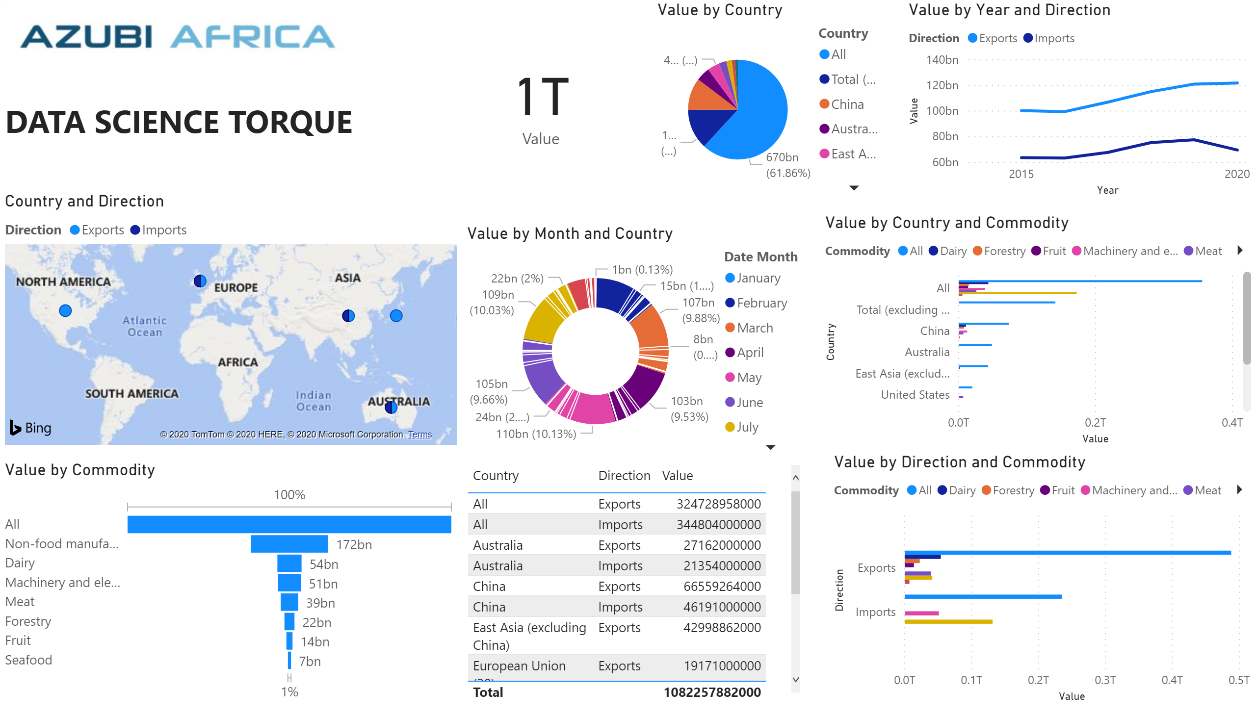
ANALYSIS
DS TORQUE

Slide 11
DS TORQUE
Implications
Trades volumes dropped during the COVID-19 pandemic significantly.
Significant revenue losses.
Loss of potential market.

Slide 12
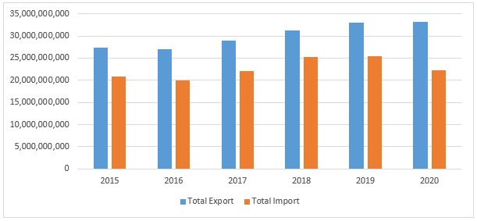
ANALYSIS CONTINUATION
DS TORQUE

Slide 13
DS TORQUE
Deep Dive on Solution
Government and the aviation sector should put measure in place to ensure trades are not cancelled.
Support from The Treasury's New Zealand Export Credit (NZEC) may be able to provide support for exporters experiencing difficulties resulting from COVID-19.
Strengthen bilateral relation for other countries like Ghana.
Increase market for export to other countries like Ghana.
SDHDJID

Slide 14
DS TORQUE
Summary and Call for Action
New Zealand government should establish new bilateral relations with countries that did fairly well in containing the spread of the pandemic to improve its trade. This is because most of the partner countries in Asia like China, Japan and other countries like US were all heavily affected.
Ghana can take advantage of this new normal to strengthen ties with New Zealand to improve on it‘s trade relations.

Slide 15
Thank you
DS TORQUE

